Slide 1

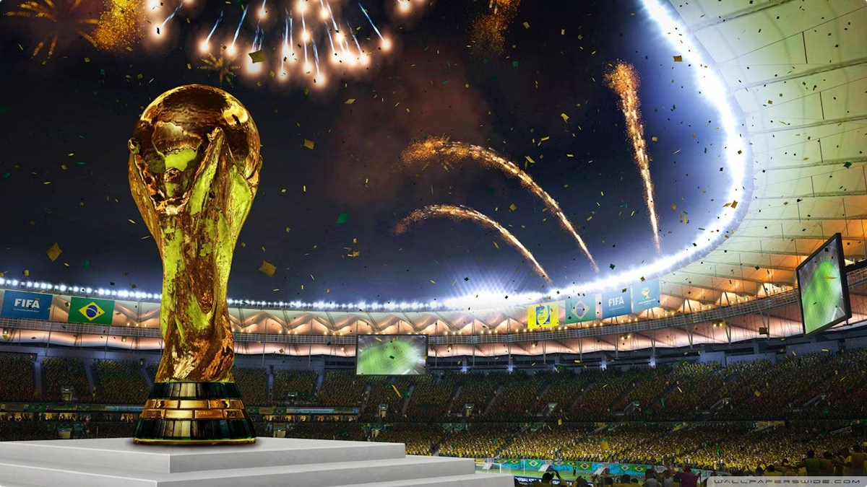
FIFA World Cup Data Analysis
FIFA, founded in 1904, governs international football. It organizes major tournaments like the World Cup and promotes the sport globally. This analysis explores World Cup data, revealing insights into teams, players, and tournament trends.

Slide 2

World Cup Stages
Group Stage
1
32 teams divided into 8 groups play round-robin matches.
2
Round of 16
Top two teams from each group advance to knockout stage.
Quarter-Finals
3
8 teams compete in single-elimination matches.
4
Semi-Finals and Finals
4 teams play semi-finals, winners advance to final match.

Slide 3
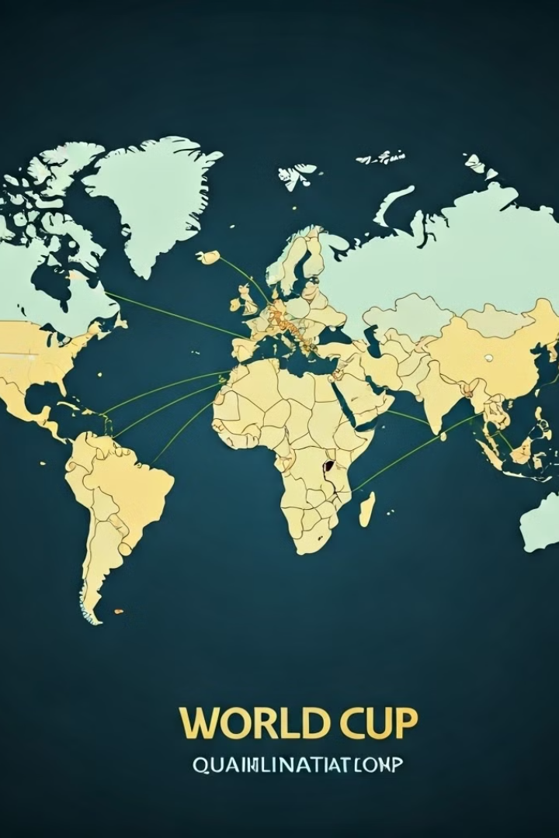



Qualification Process
Regional Qualifiers
Teams compete in confederation-specific tournaments to secure World Cup spots.
Intercontinental Playoffs
Teams from different continents compete for final World Cup spots.
Group Stage Draw
Qualified teams are divided into groups for the main tournament.

Slide 4
Top Performing Countries
World Cup Appearances
Winning Trends
Host Nation Success
Brazil and Germany lead with 78 matches each, followed by Italy with 57.
Brazil tops with 58 wins, Germany follows with 53, and Argentina with 39.
Six host countries have won the World Cup on home soil.

Slide 5
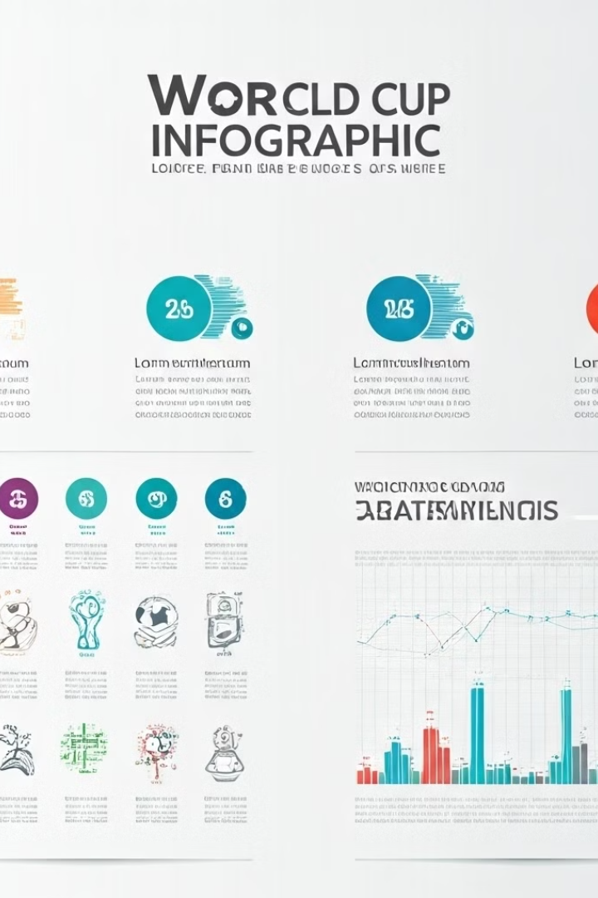
Tournament Statistics
Average Goals per Match
2.85
Highest Attendance
173,850 (Uruguay)
Most Common Matchup
Brazil vs. Sweden
Biggest Win
Hungary 10-1 El Salvador (1982)

Slide 6





Player and Coach Highlights
Top Scorer
Ronaldo leads with 13 goals, followed by Klose with 12.
Top Coach
Luiz Felipe Scolari has 575 World Cup appearances.
Most Wins
Brazil leads with 5 World Cup victories.

Slide 7
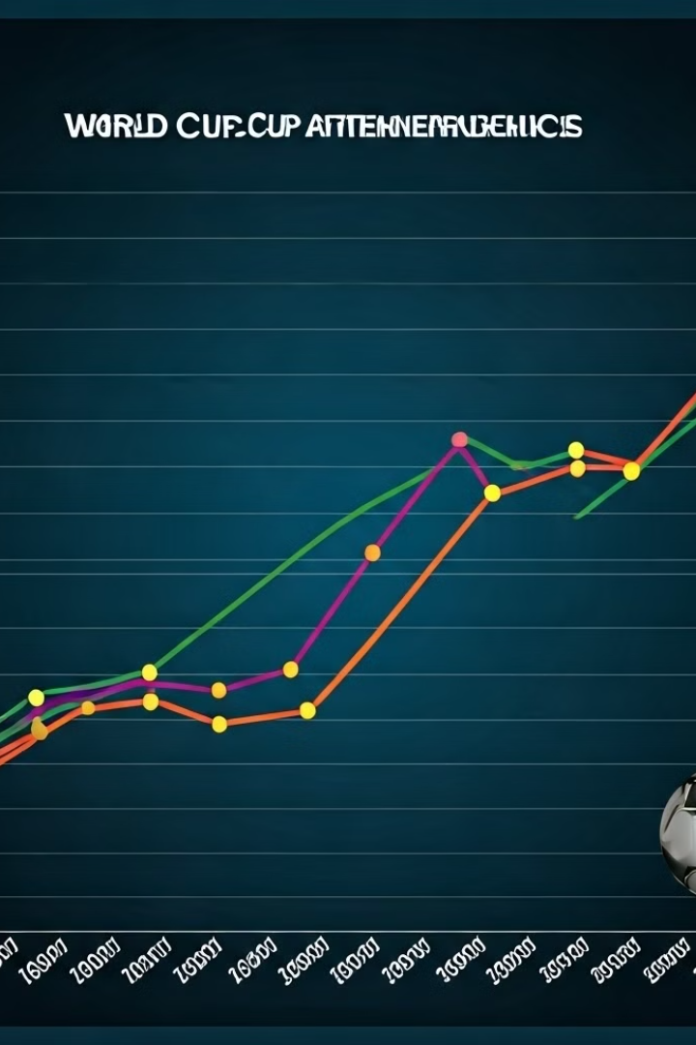
Tournament Trends
1
Goal Scoring
Goals increased from 70 in 1930 to 171 in 1998 and 2014.
2
Attendance
Spectators rose from 590,549 in 1930 to over 3 million in recent tournaments.
3
Penalty Shootouts
Becoming more common in knockout stages, with Germany showing strong performance.

Slide 8

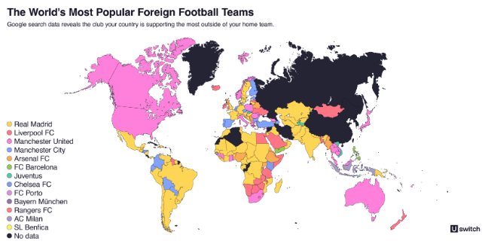
Regional Performance
Europe
South America
Other Regions
European teams have won the World Cup 12 times.
South American teams have secured 9 World Cup victories.
No team outside Europe or South America has won the World Cup yet.

